Slide 1
Content Marketing Plan- Alumni Channel
Samiksha Kataria
DEC 09,2023

Slide 2
Audience Requirements - Anecdotes
Professional Development is all well and good but the unique thing Commlead can provide beyond any other source of education is access to other alumni. I want to know where they are and what they are up to.
I want to keep the door open to my next career change. So it’s good to engage with other Commleaders - there’s a lot of pride in where you went to school and trust.
I would love to meet more Commlead alumni to hire. I feel like I meet people who are just starting out or who are new to a task but I know there are dozens of Commlead alumni who are experts in this field. How can I meet them and add them to my network of people to hire or recommend?
My day to day job is social media. I’m overwhelmed by too many channels
I’d be down to learn to cook or dance or learn a new hack in Figma. The point is that I trust Commlead people. I know it would be worth my time

Slide 3
Other Anecdotes that matter
Content should be More transformational than transactional
Make it more clear how and where to participate. Make it more clear that alumni are invited and welcome
Hosting events or having featurette stories is a way to start.
We have too many channels
My day to day job is social media. I’m overwhelmed by too many channels.
Not make it about work all the time, have chances to get to know each other
Social media is not the place to host content marketing. It is a place to advertise content marketing and link to it

Slide 4
Campaign Idea
Idea Details
Audience Engagement
It is the one-stop shop where alumni can connect, learn and empower each other. Under a free channel like Discord, alumni will learn more about latest trends, be able to help each other with job search and will also be able to connect with alumni located in the same region as them.
It solves for the alumni need to have a single point of contact away from social media.
This lets them stay connected, while being a part in each other’s journey and solves for a lot of their concerns addressed.

Slide 5
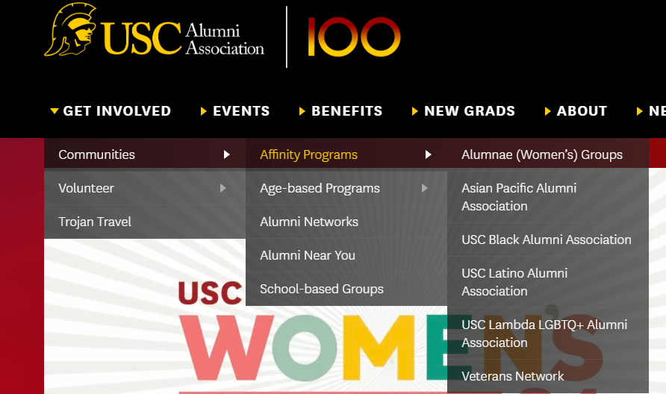
Inspiration for activities or groups
Notes:
https://alumni-friends.brown.edu/

Slide 6
Campaign Overview
A dedicated alumni Discord/Teams channel
Will be the one big solution to solve for many issues alumni have addressed
It can incorporate any ideas for events or collaboration that we would want to implement
Can have sub-channels to solve communication issues
Will be moderated by someone from commlead staff
3 main causes I am planning to initially address-
Address wanting to learn something new or gain knowledge
Address the want to stay in touch with other alumni
Give them a chance to connect to alumni in their location
Give them an opportunity to take collaborate during job switch process-
Notes:
Like Anneberg website : https://alumni.usc.edu/

Slide 7
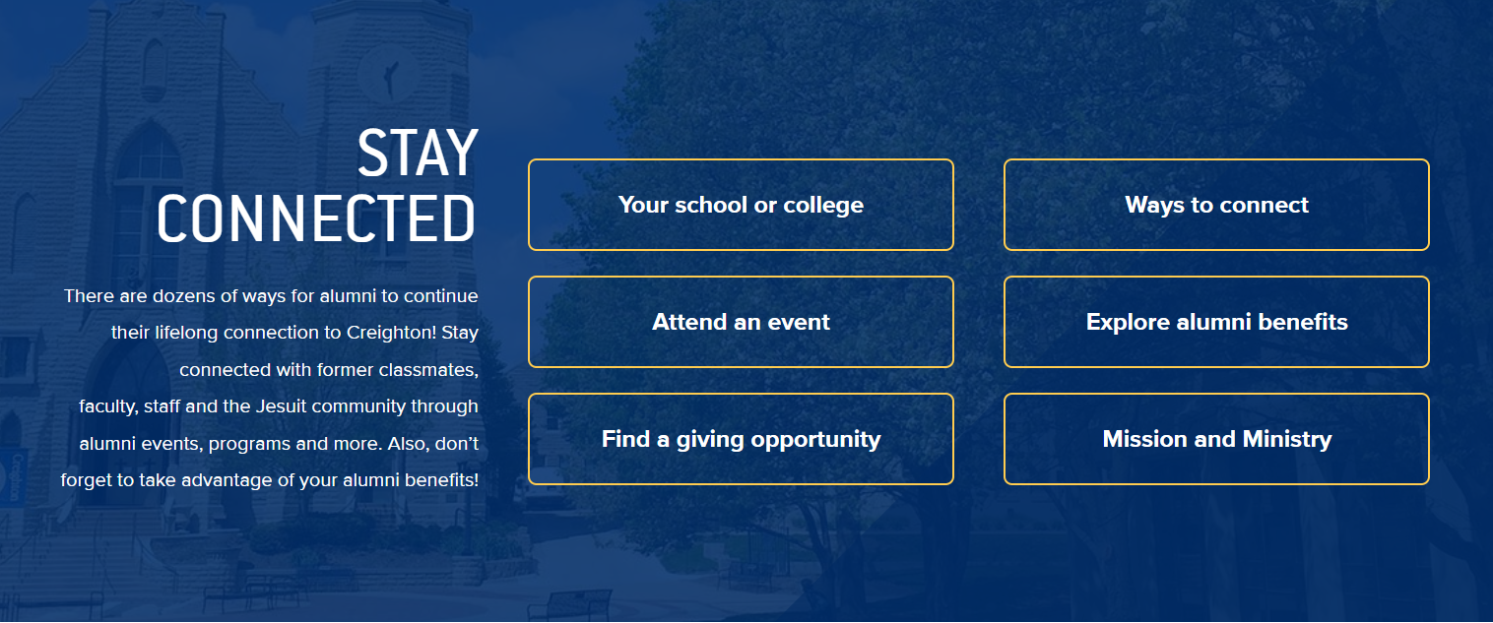
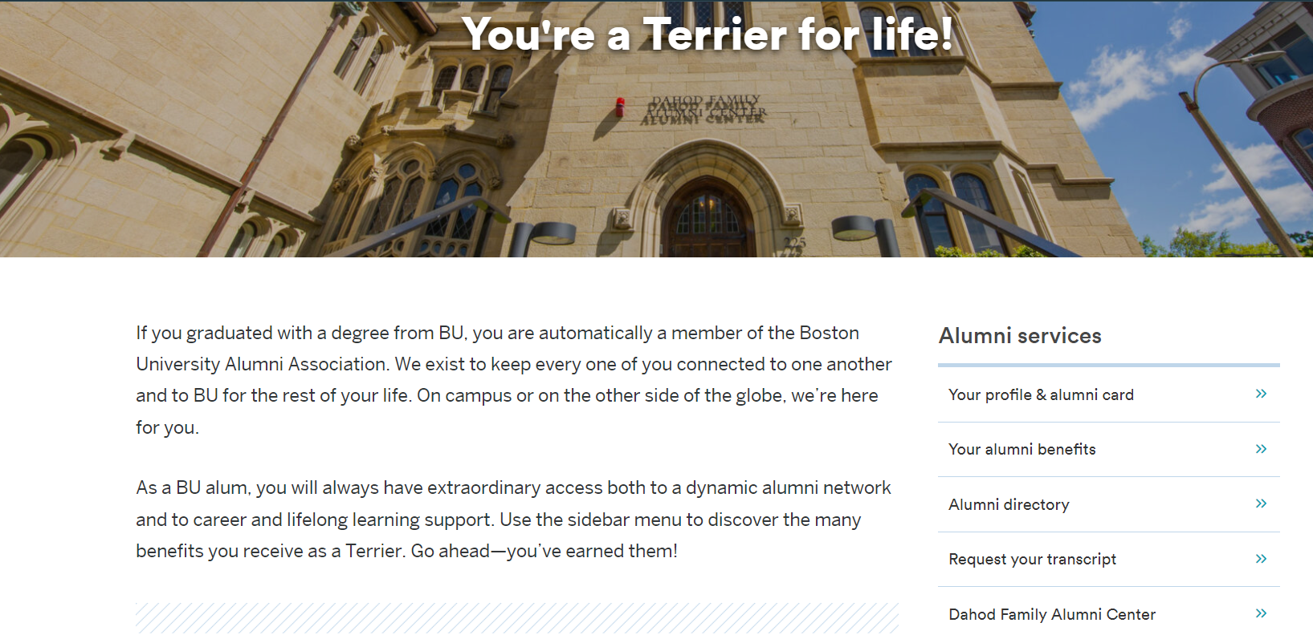
More Visual Inspiration
Notes:
https://www.bu.edu/alumni/services/

Slide 8
Campaign Channel 1- LearningHub
Idea Details
Audience Goals
Hosting alumni-special collab sessions for every seminar or learning event organized by Commlead.
Quarterly sessions by faculties of Commlead to help alumni stay up to date on market trends.
Quarterly sessions can also be hosted by alumni if they wish to.
Drive Awareness
This will pull in alumni who did not stay in touch with Commlead because of social media. Once they see there is a lot to gain in this channel, they might pull in their friends too. This will help increase the outreach.

Slide 9
Channel 1 : Details
Letting alumni be a part of all commlead info sessions like First Friday, and hosting a alumni only collab session on this channel.
Letting alumni volunteer to teach others any latest trending topic or technology they are leveraging their workspace (we dont ask them to do it every time, but let them volunteer)
Having a commlead faculty host a quarterly info session to help the alumni learn a new skill and to keep them in touch with what students are being taught.
On chat, the moderator can bring up polls on topics everyone wants to discuss and initiate conversations about how people are leveraging various tools during their work

Slide 10
Campaign Channel 2- Job Hunt
Idea Details
Audience Goals
For alumni looking to switch jobs or find new jobs
Can be collab sessions, help with interviews or just a discussion about job market
Will also be useful to help them get hired with each other’s companies
Nurture Fandom/Community
The more you give, the more you get. Their want to help each other and recruit each other will get fulfilled. This will lead to alumni participation and commlead promotion organically.

Slide 11
Channel 2- Details
Ask alumni to join the channel only if they are looking for a job.
Encourage alumni who are hiring to share with other alumni and facilitate the commlead hires commlead idea.
For alumni whose companies are hiring, they can help with referrals, interview preparations or helping them find the right people to connect with
Moderator ensures to keep conversations about job market alive if they die down for a long time.
This will result in alumni getting hired by each other, and their willingness to pay it back by trying to hire other commleaders when they get the turn.

Slide 12
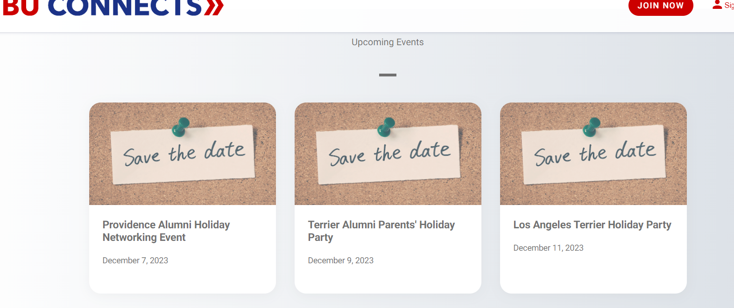
Campaign Channel 3- Area Based Meetups
Make sub channels for alumni based in different locations like Bay area, NYC and other popular locations and host events in these to help the alumni meet and connect.
Example of Boston university alumni page

Slide 13
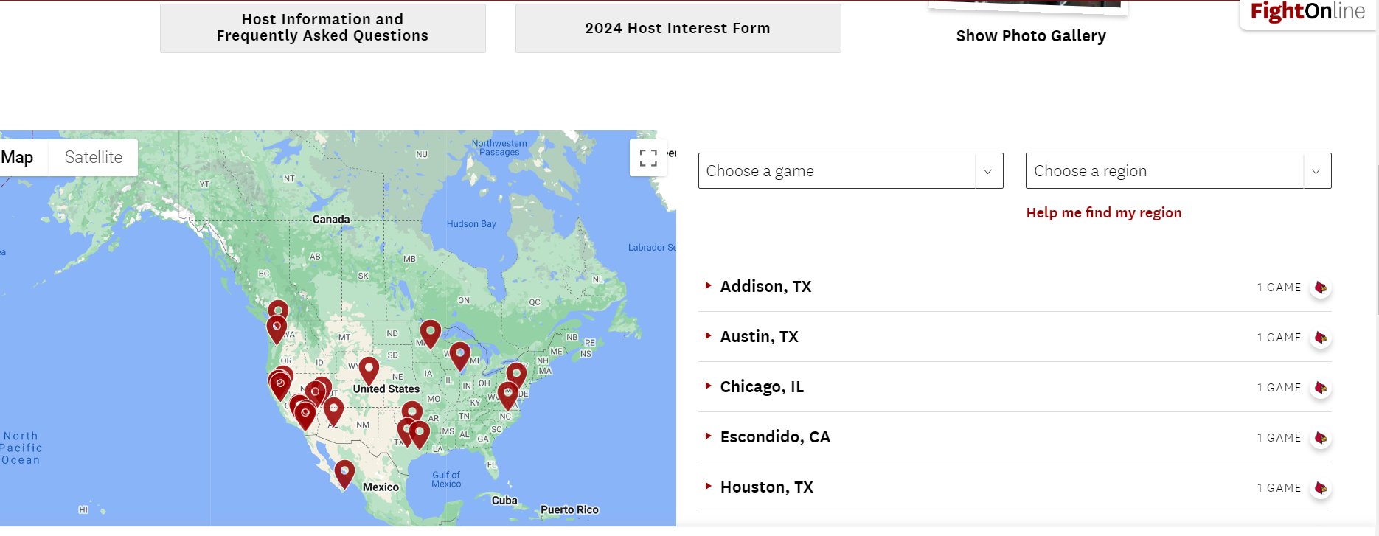
Host holiday gatherings/ watch parties for UW games, for alumni in particular locations. This can be done by asking alumni to volunteer to host, or having them gather in a pub or park. This would be no cost to Commlead and we would just be the planners of events in this case.

Slide 14
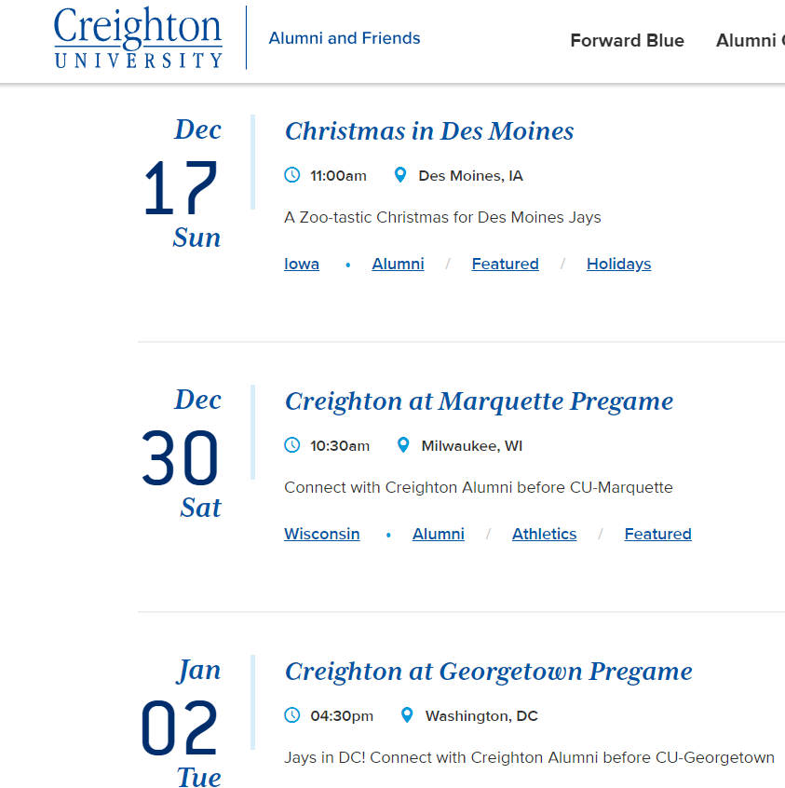
Audience Goal
Increase Participation:
Makes them feel connected to Commlead even if they are away from Seattle. They can form new bonds or re-establish old ones with meetups, watch parties and get togethers.
This will increase their participation in general events and make them want to contribute more towards the Commlead family.

Slide 15
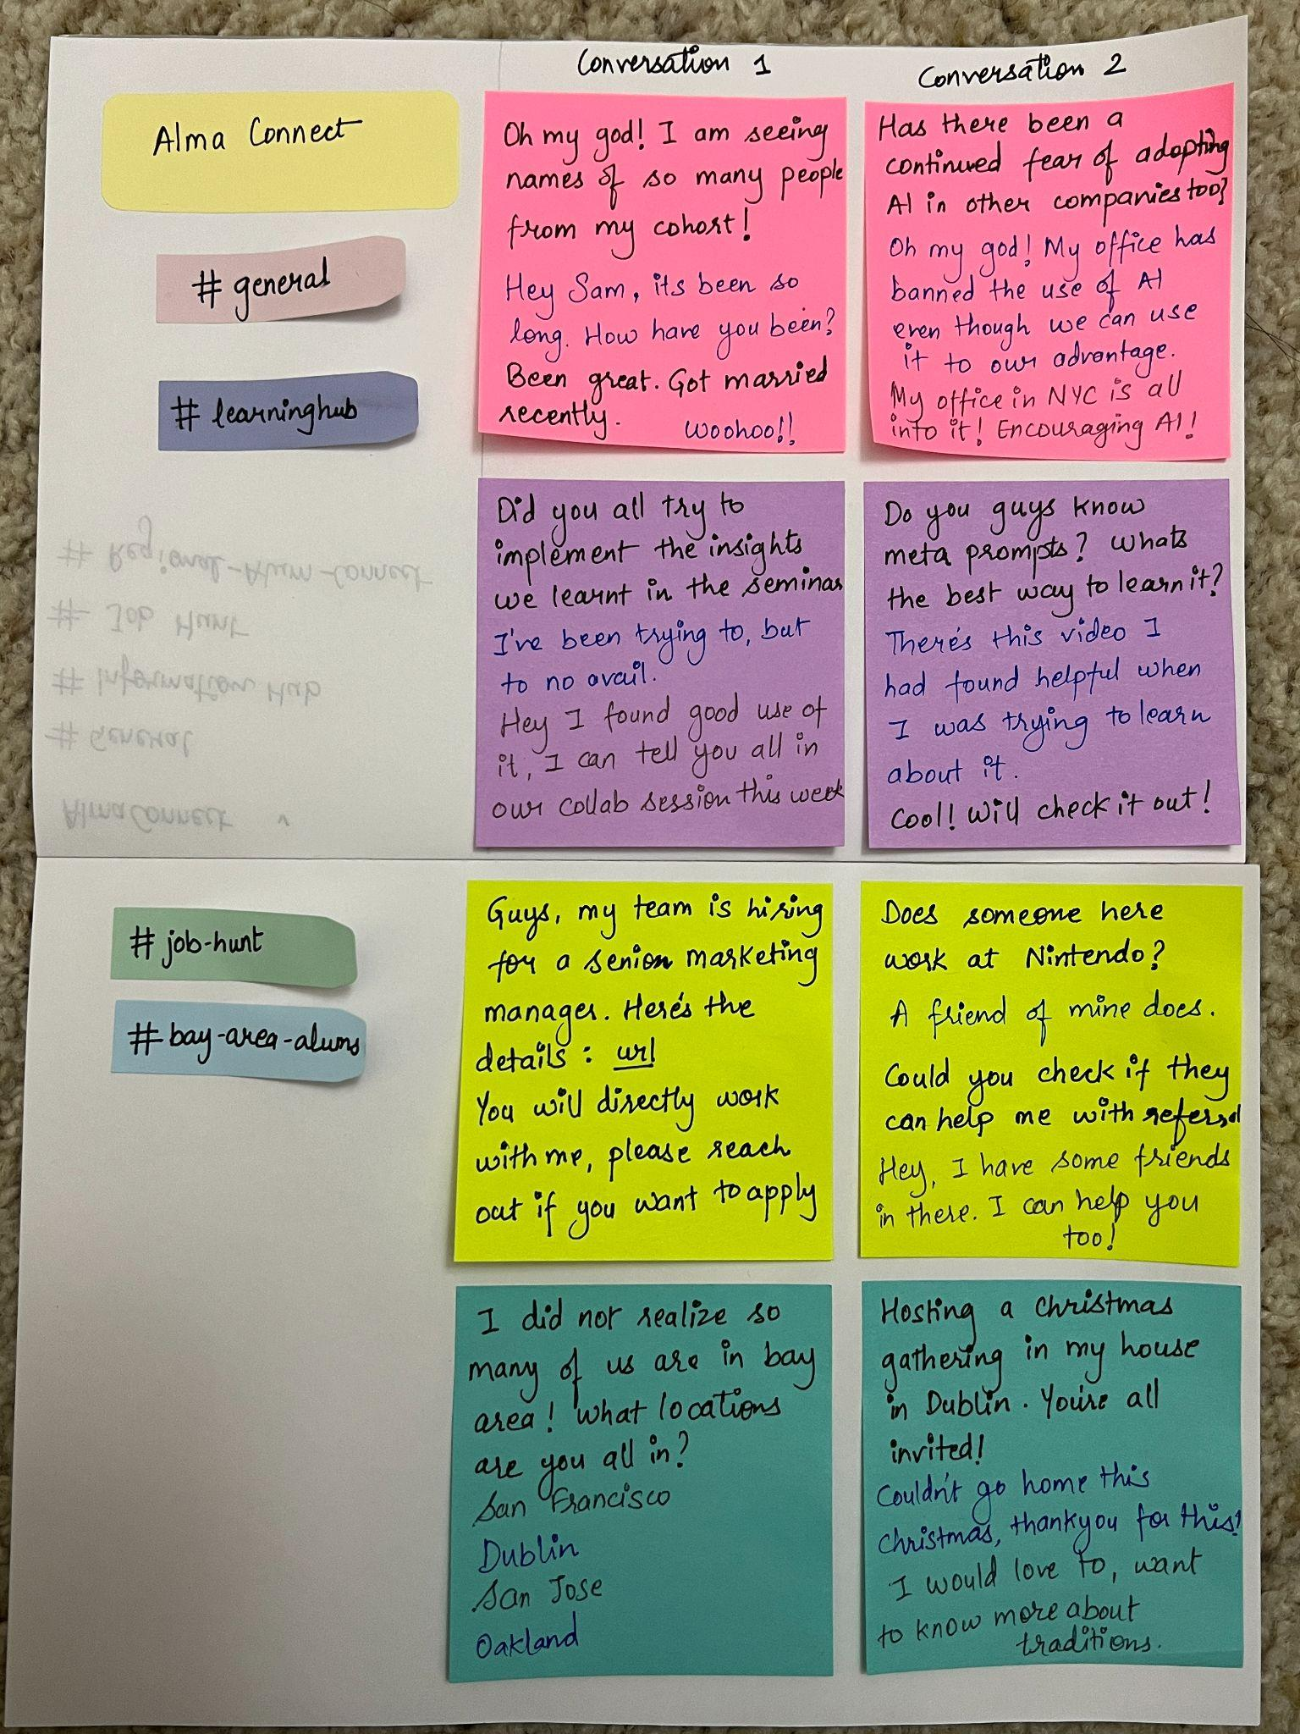
Content Plan:
Visualization of how channels will look and sample discussions to happen in each of those.
Notes:
Text written with different colors represents different people talking in the chat. Not sure how visible it is in the image, but hopefully the different text colors and sticky note colors are self understood.

Slide 16
Moderator Tasks
Ensuring only the alumni get to join this group
Creating content to initiate first conversations on each channel and perfect descriptions to be written with each channel to help alumni understand what they do
Ensuring the conversations are respectful, inclusive and relevant
Initiating good conversations on each group when there is a die down in conversations
Reading chats to understand the pulse of what alumni want to hear about, what features can be added on, or what next topics of sessions should be.
Planning and communicating collab sessions after every Commlead seminar
Helping people host and plan events based on their particular locations
Communicating to Commlead what new ideas spring up on the group about what the market needs

Slide 17
Measuring Success
Number of alumni that join this channel
Daily active users on the channel
Amount of meetups planned in specific locations
Quality of discussions on the group
Number of alumni signing up for collab sessions
Number of people who actually find help/ find a job through the communication on this channel
Alumni feedback after a few months of having this channel to see if this has been useful for them

Slide 18
Future Expansion
If this is a success, this channel could be converted to a dedicated space on the commlead website.
This channel can also help understand the content that works, to launch a separate alumni website altogether and invest into making it the dedicated alumni portal for all events, meetups and connections.
This can then be as detailed and engaging as the time and budget allow Commlead, but this website could help the alumni have the feeling of exclusivity and continued involvement.

Slide 19
ThankYou

Slide 20
Appendix
Planning Doc:
https://docs.google.com/spreadsheets/d/1sOXzwoiLpgG7IJH9TF0WbhLOFILTEgdu/edit#gid=2103254584

Slide 21
Referred Links
https://alumni-friends.brown.edu/
https://alumni.stanford.edu/
https://support.discord.com/hc/en-us/articles/360045138571-Beginner-s-Guide-to-Discord
https://www.oho.com/blog/college-university-alumni-websites
https://alumni.creighton.edu/

